Slide 1
Reminders
March 10: Email me group members March 15: HW deadline March 20: Proposal deadline
March 20 and 22: Proposal Presentations
No classes March 13 and 15.
(organizing conference in Germany)
Last chance to meet about project this week.
Scribe for Today

Slide 2
Reminders
Ideas for projects:
Large vs small batch SGD
Generalization of GD models when training NNs
Async vs Sync speedups
Robustness models against adversarial attacks
Robustness vs generalization
Adversarial attacks during distributed training
Low communication distributed ML
Quantization of models/gradients
Cache optimized SGD
Optimizing network + data structures for training
Generalization of Distributed/Parallel Algorithms

Slide 3
ECE901
Dimitris Papailiopoulos
Lifting Synchronization Barriers

Slide 4
Today
Stragglers in Synchronous Distributed Optimization
Lifting Synchronization Barriers
HogWild!

Slide 5
Stochastic Gradient Descent
Idea (‘50s, ‘60s [Robbins, Monro], [Widrow, Hoff]):
Sample a data point + locally optimize.
loss for data point i
SGD: An Über-algorithm

Slide 6
Stochastic Gradient Descent
SGD can take 10+ days on large data sets
[DawnBench, 2017]
Goal:
Speed up Machine Learning

Slide 7
Scaling Up SGD

Slide 8
Synchronous computation

Slide 9
Algorithm of choice: minibatch SGD

Slide 10
Algorithm of choice: minibatch SGD
Stores the model
Gradient Computations

Slide 11
Algorithm of choice: minibatch SGD

Slide 12
Algorithm of choice: minibatch SGD
B = batch size,
gradients / iteration

Slide 13
Algorithm of choice: minibatch SGD

Slide 14
Algorithm of choice: minibatch SGD

Slide 15
Algorithm of choice: minibatch SGD
Repeat distributed iterations until
we are happy with the model

Slide 16
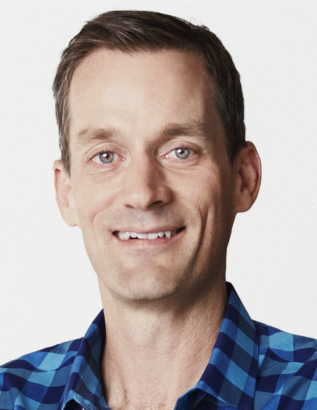
Large-scale Distributed Machine Learning Systems
Storage
Communication
Computation
1
Δ
1
Δ
Distributed Data Storage
Δ
2
Δ
2
Aggregator
Data
Δ
Network
Δ
Δ
Δ
n
Δ
n
Δ
“The scale and complexity of modern Web services make it infeasible to eliminate all latency variability.”
Jeff Dean, Google.
Notes:
Large-scale computing systems have 3 main layers: Storage layer, Communication Layer, and Computation Layer. Data is read from the storage layer, and transmitted through the network towards the computing nodes. The new results of computation are then stored again to complete the loop. each of these steps incurs some delay and uncertainty. Can codes robustify algorithms against this system noise?

Slide 17
Stragglers
Ideal compute time per node ~ O(total_time/P)
But there is a lot of randomness:
Network/Comm Delays
Node/HW Failures
Resource Sharing
What if time per node is a random variable:
X = constant + Exp(λ)
Lemma:
Remark:
Slowest node is
log(n) times slower
than fastest

Slide 18
Simulation
X(t) = 1+ Exp(0.5), n = 10, 100, 1000, 1000
Straggler issue:
leads to slower mini-batch SGD implementations

Slide 19


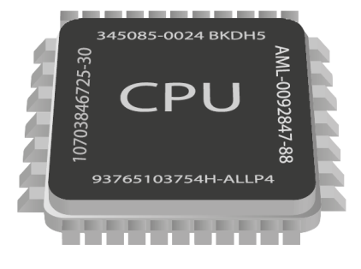
Bottleneck: Straggling Learners
model
model
model
model
model
Can we “robustify” distributed ML
against stragglers?
Measured on Amazon AWS

Slide 20
A case against Synchronization
overheads
timeline
CPU 1
CPU 2
CPU 3
stragglers
Asynchronous World
CPU 1
CPU 2
Faster
CPU 3
Easier to Implement

Slide 21
Asynchronous SGD on Sparse Functions

Slide 22
SGD on sparse functions
Def:
Hyperedge = the subset of variables that depends on
The function-variable graph
Matrix Fact./Comp.
Graph cuts
Graph/text Classification
Topic Modeling
Dropout
…

Slide 23










SGD on sparse functions
Data points
Model
1
Sample
2
2
3
4
Step1: Pick random data point

Slide 24
SGD on sparse functions
Data points
Model
1
Read
2
3
4
Step 2:
Read Variables

Slide 25
SGD on sparse functions
Data points
Model
1
Compute grad. of local loss
2
3
4
Step3:
Compute local function

Slide 26
SGD on sparse functions
Data points
Model
1
Update Model
2
3
4
Step4:
Update Model

Slide 27
Parallelizing Sparse SGD on shared memory architectures

Slide 28
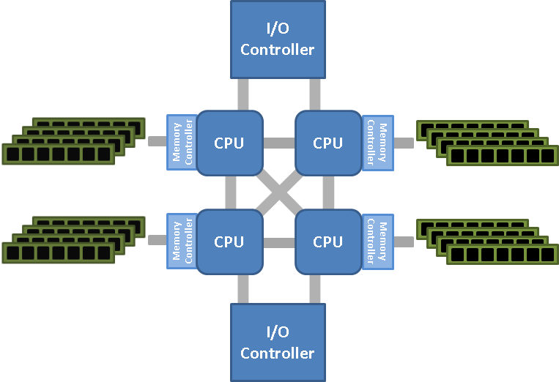
Single Machine, Multi-core

Slide 29

Challenges in Parallel SGD
data points
shared variables
No conflict =>
2 parallel iterations = 2 serial iterations

Slide 30
Challenges in Parallel SGD
data points
shared variables
No conflict => Speedup

Slide 31
Challenges in Parallel SGD
data points
shared variables
oops, conflicts
What should we do for conflicts?
Approach 1: Coordinate or Lock
Approach 2: Don’t Care (Lock-free Async.)

Slide 32

Prior to 2011 Work
Long line of theoretical work since the 60s [Chazan, Miranker, 1969]
Foundational work on Asynchronous Optimization Master/Worker model [Tsitsiklis, Bertsekas, 1986, 1989]
Recent hardware/software advances renewed the interest Round-robin approach [Zinkevich, Langford, Smola, 2009] Average Runs [Zinkevich et al., 2009], Average Gradients [Duchi et al, Dekel et al. 2010]
Many based on “Coordinate” or “Lock” approach
Why Coordinate or Lock?
Issue: Synchronization and comm. overheads

Slide 33
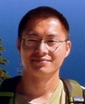




HOGWILD! 2011
“Run parallel lock-free SGD without synchronization”
Niu
Recht
Ré
Wright
SVM RCV1 (10 cores)
Each processor in parallel
Impact
Downpour SGD, Project Adam use HOGWILD!
Renewed interest on async. optimization

Slide 34
Challenges in Analysis

Slide 35
Challenges in Hogwild!
Shared Memory
Processor 1
Issues:
1. updates can be old
2. results can overwritten
Processor 2
Processor P
Incompatible with classic SGD analysis

Slide 36
How to Analyze Hogwild?
Measure of performance
Goal of a Hogwild Analysis
Prove that Parallel SGD and Serial SGD have similar convergence rates for given number of samples
Assumption:
random sampling of gradients yields a nearly optimal load balance
(if number of cores not too many)

Slide 37
How to Analyze Hogwild?
- [Niu, Recht, Re, and Wright, 2011] the first analysis of Hogwild! Issues:
- many impractical assumptions
- simplified read/write model
[consistent reads, single coordinate updates, …]
- lengthy derivations
Many Async. algorithms follow using similar assumptions, and/or analysis:
[Duchi et al, 2011], [Liu et al, 2014, 2015], [Avron et al. 2014],
[De Sa et al, 2015], [Lian et al., 2015], [Peng et al., 2015]

Slide 38
How to Analyze?
General Framework for
Asynchronous Lock-free Algorithms?
- [Niu, Recht, Re, and Wright, 2011] give the first
convergence analysis of Hogwild! Issues:
- (over) simplified read/write model. [consistent reads, single coordinate updates, etc]
- lengthy derivations
Several Async+lock-free algorithms follow
using similar assumptions, and/or analysis:
- [Duchi et al, 2011], [Liu et al, 2014, 2015], [Avron et al. 2014], [De Sa et al, 2015], [Lian et al., 2015], [Peng et al., 2015]

Slide 39
Analyzing Asynchronous Schemes

Slide 40
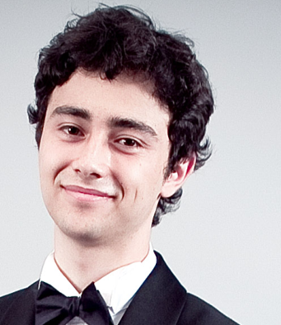



A Noisy Lens for Asynchronous Algorithms
Main Idea
Noisy viewpoint:
Asynchronous(Algo.( INPUT )) Serial(Algo.(INPUT + Noise)
Perturbed Iterate Analysis for Asynchronous Stochastic Optimization
[Mania, Pan, P, Recht, Ramchandran, Jordan, 2015]
Joint work with

Slide 41
HOGWILD! as noisy SGD
Each processor in parallel
Def: is the k-th sampled data point
Fact: Cores don’t read “actual” iterates but “noisy iterates”
After T processed samples, the contents of RAM are:
(atomic writes + commutativity)
Ex.

Slide 42
HOGWILD! as noisy SGD
Each processor in parallel
Def: is the k-th sampled data point
Fact: Cores don’t read “actual” iterates but “noisy iterates”
After T processed samples, the contents of RAM are:
(atomic writes + commutativity)
Ex.
Core 1
Core 2
Core 3
RAM
1
0
0
050
017
000

Slide 43
HOGWILD! as noisy SGD
Each processor in parallel
Def: is the k-th sampled data point
Fact: Cores don’t read “actual” iterates but “noisy iterates”
After T processed samples, the contents of RAM are:
(atomic writes + commutativity)
Ex.
Core 1
Core 2
Core 3
RAM
1
0
0
050
017
000

Slide 44
HOGWILD! as noisy SGD
Each processor in parallel
Def: is the k-th sampled data point
Fact: Cores don’t read “actual” iterates but “noisy iterates”
After T processed samples, the contents of RAM are:
(atomic writes + commutativity)
Ex.
Core 1
Core 2
Core 3
RAM
1
0
0
050
017
050

Slide 45
HOGWILD! as noisy SGD
Each processor in parallel
Def: is the k-th sampled data point
Fact: Cores don’t read “actual” iterates but “noisy iterates”
After T processed samples, the contents of RAM are:
(atomic writes + commutativity)
Ex.
Core 1
Core 2
Core 3
RAM
1
0
0
050
017
050

Slide 46
HOGWILD! as noisy SGD
Each processor in parallel
Def: is the k-th sampled data point
Fact: Cores don’t read “actual” iterates but “noisy iterates”
After T processed samples, the contents of RAM are:
(atomic writes + commutativity)
Ex.
Core 1
Core 2
Core 3
RAM
1
0
0
050
017
150

Slide 47
HOGWILD! as noisy SGD
Each processor in parallel
Def: is the k-th sampled data point
Fact: Cores don’t read “actual” iterates but “noisy iterates”
After T processed samples, the contents of RAM are:
(atomic writes + commutativity)
Ex.
Core 1
Core 2
Core 3
RAM
1
0
0
050
017
160

Slide 48
HOGWILD! as noisy SGD
Each processor in parallel
Def: is the k-th sampled data point
Fact: Cores don’t read “actual” iterates but “noisy iterates”
After T processed samples, the contents of RAM are:
(atomic writes + commutativity)
Ex.
Core 1
Core 2
Core 3
RAM
1
0
0
050
017
167

Slide 49
HOGWILD! as noisy SGD
Each processor in parallel
Def: is the k-th sampled data point
Fact: Cores don’t read “actual” iterates but “noisy iterates”
After T processed samples, the contents of RAM are:
(atomic writes + commutativity)
The algorithmic progress is captured by ``phantom” iterates
Main Questions:
Where does noise come from?
How strong is it?

Slide 50
Convergence Rates for Noisy SGD
We want to analyze noisy SGD
Elementary analysis (using m-strong convexity assumption on f):
Simple Lemma:
if both terms = ,
Noisy SGD gets same rates as SGD (up to multiplicative constants)
aka SGD robust to small perturbations
So.. is asynchrony noise small?

Slide 51
Understanding Asynchrony Noise
timeline
CPU 1
Sample 1
CPU 2
Sample 2
CPU 3
Sample 3

Slide 52
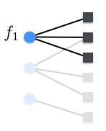
Understanding Asynchrony Noise
timeline
CPU 1
Sample 1
CPU 2
Sample 2
CPU 3
Sample 3
“Serialized” Processing Timeline

Slide 53
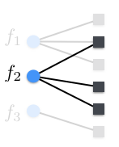
Understanding Asynchrony Noise
timeline
CPU 1
Sample 1
CPU 2
Sample 2
CPU 3
Sample 3
“Serialized” Processing Timeline

Slide 54
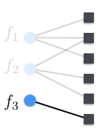
Understanding Asynchrony Noise
timeline
CPU 1
Sample 1
CPU 2
Sample 2
CPU 3
Sample 3
“Serialized” Processing Timeline

Slide 55
Understanding Asynchrony Noise
timeline
CPU 1
Sample 1
CPU 2
Sample 2
CPU 3
Sample 3
“Serialized” Processing Timeline
Asynchrony noise is combinatorial
coordinates in conflict can be as noisy as possible.
(no generative model assumptions)
Q: What causes asynchrony “noise”? A: “noisy reads” of the coordinates in the overlap

Slide 56
Next Time
Hogwild! Analysis for Sparse Functions
Update Confict Graphs
Challenges of Hogwild! and Serializability

